Slide 1
Lecture 07 – CNN Applications and Tricks
Prof. André Gustavo Hochuli
gustavo.hochuli@pucpr.br
aghochuli@ppgia.pucpr.br
Notes:
Prof. André Hochuli

Slide 2
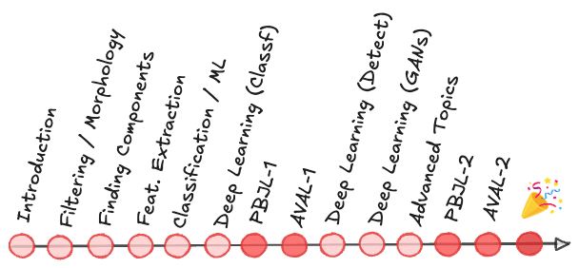
Topics
Convolutional Neural Network
Basic Concepts
Archicteture and Hiper Parameters
Overfitting
Data Augmentation
Transfer-Learning
Applications
State of The Art Architectures
Practice
Computer Vision - Prof. André Hochuli
Lecture 07
Notes:
Prof. André Hochuli

Slide 3
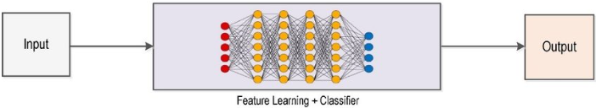
Deep Learning Pipeline
Computer Vision - Prof. André Hochuli
Lecture 07
Notes:
Prof. André Hochuli

Slide 4
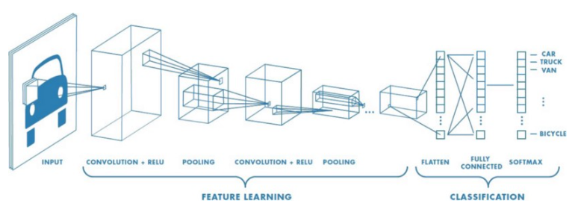
Convolutional Neural Network
CNN
Computer Vision - Prof. André Hochuli
Lecture 07
Notes:
Prof. André Hochuli

Slide 5
Convolutional Neural Network
Feature Extraction
Computer Vision - Prof. André Hochuli
Lecture 07
Notes:
Prof. André Hochuli

Slide 6
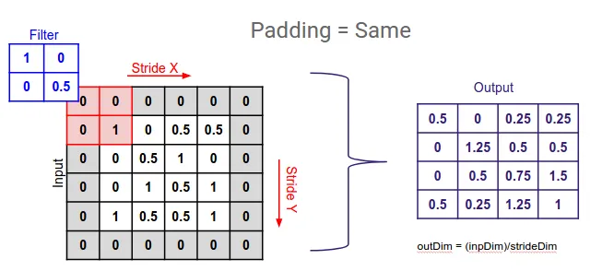
Convolutional Neural Network
Convolutional Layer (Learnable Filters)
Padding
Stride
Kernel Size
Number of Filters
Computer Vision - Prof. André Hochuli
Lecture 07
Notes:
Prof. André Hochuli

Slide 7
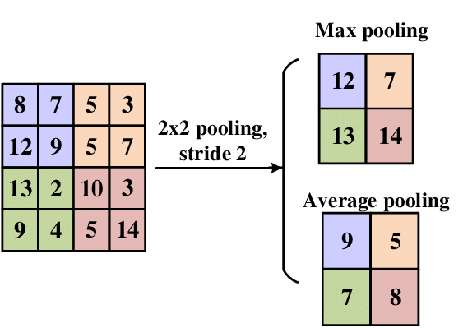
Convolutional Neural Network
Pooling Layer
Reduce Spatial Dimensions
Translation-Invariant
Common Filter
Max: Preserve the “strongest” features
Average: Smooth features, preserves general representations
Computer Vision - Prof. André Hochuli
Lecture 07
Notes:
Prof. André Hochuli

Slide 8

Convolutional Neural Network
Classification
Forward and Back Propagation
Computer Vision - Prof. André Hochuli
Lecture 07
Notes:
Prof. André Hochuli

Slide 9
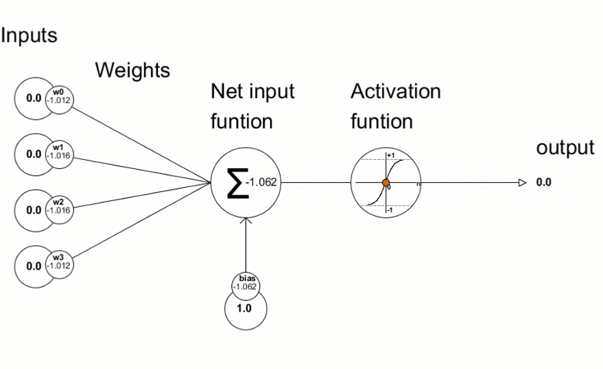
Convolutional Neural Network
Forward and Back Propagation
Computer Vision - Prof. André Hochuli
Lecture 07
Notes:
Prof. André Hochuli

Slide 10

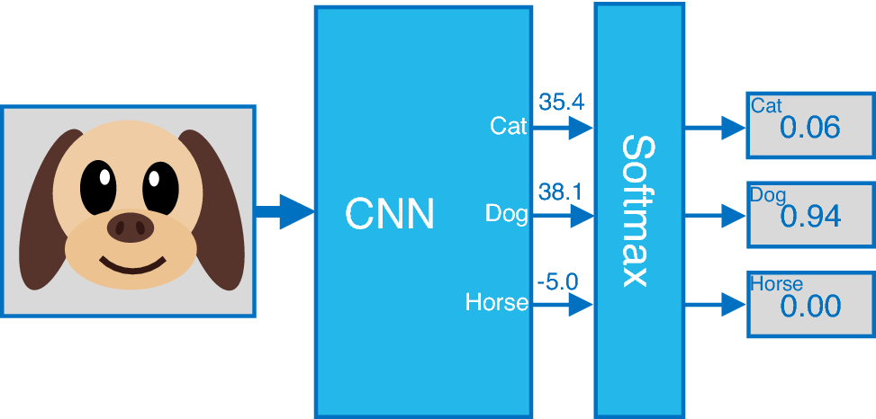
Convolutional Neural Network
Softmax
Computer Vision - Prof. André Hochuli
Lecture 07
Notes:
Prof. André Hochuli

Slide 11
Convolutional Neural Network
Lets code our first CNN from scratch
Lecture 07 - CNN Architecture
Computer Vision - Prof. André Hochuli
Lecture 07
Notes:
Prof. André Hochuli

Slide 12
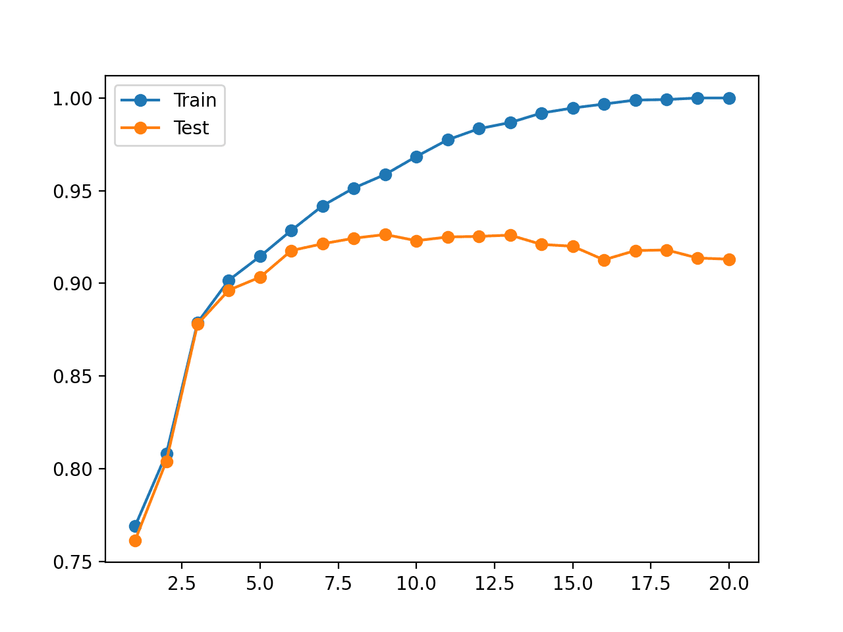

Overfitting
Overfitting occurs when a model captures noise or specific patterns in the training data, impairing its ability to generalize to unseen data. Strategies such as regularization, dropout, data augmentation, and transfer learning help mitigate this by controlling model complexity and leveraging pre-learned features.
Computer Vision - Prof. André Hochuli
Lecture 07
Notes:
Prof. André Hochuli

Slide 13
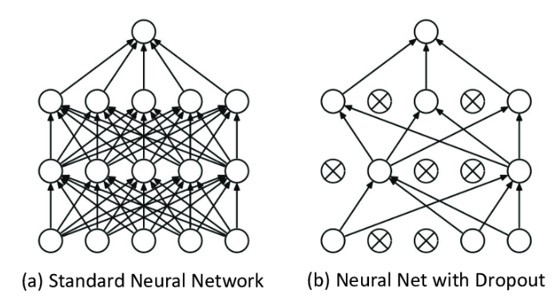
Dropout
Dropout is a regularization technique that randomly deactivates a fraction of neurons during training, forcing the model to learn redundant representations and reducing overfitting.
Computer Vision - Prof. André Hochuli
Lecture 07
Notes:
Prof. André Hochuli

Slide 14
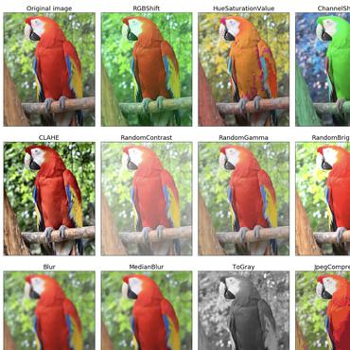
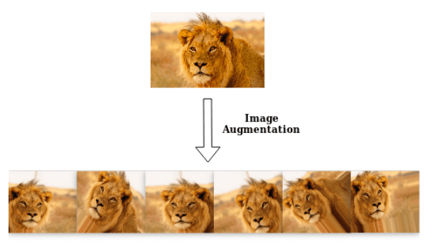
Data Augmentation
Enlarge the dataset with synthetic samples
Rotation
Crop
Brightness
Computer Vision - Prof. André Hochuli
Lecture 07
Notes:
Prof. André Hochuli

Slide 15
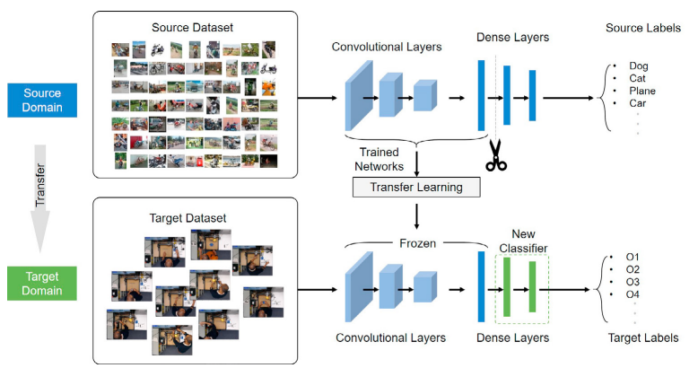
Transfer Learning
Weight Sharing
Feature Extraction weights are frozen (or not...) during learning
Computer Vision - Prof. André Hochuli
Lecture 07
Notes:
Prof. André Hochuli

Slide 16
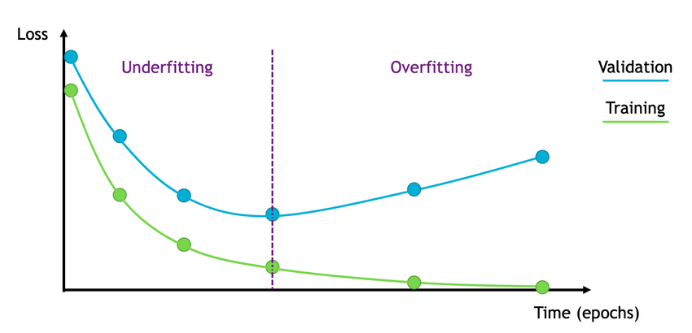
Miscellaneous
Save and Load Weights
Model Checkpoint
Resuming Training
Early Stopping
Computer Vision - Prof. André Hochuli
Lecture 07
Notes:
Prof. André Hochuli

Slide 17
State of The Art Architectures
Notes:
Prof. André Hochuli

Slide 18
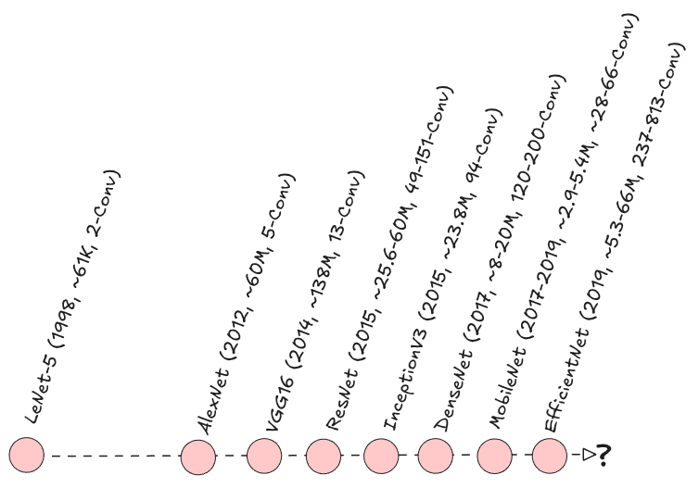
CNN Architectures Timeline
Computer Vision - Prof. André Hochuli
Lecture 07
Notes:
Prof. André Hochuli

Slide 19
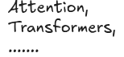
CNN Architectures Timeline
Computer Vision - Prof. André Hochuli
Lecture 07
Notes:
Prof. André Hochuli

Slide 20
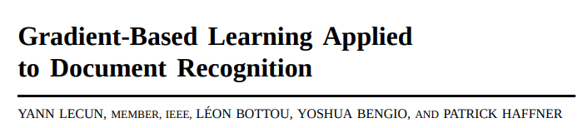
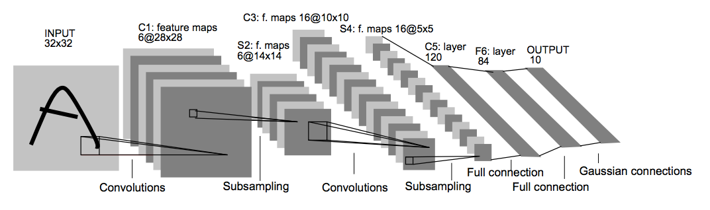
Lenet-5
Architecture: 2 Conv + Pool layers + 3 Fully Connected layers.
MNIST digit recognition.
Learned convolutional filters for feature extraction.
Parameters: ~60k trainable weights.
First widely cited CNN demonstrating effectiveness for vision tasks.
Computer Vision - Prof. André Hochuli
Lecture 07
Notes:
Prof. André Hochuli

Slide 21
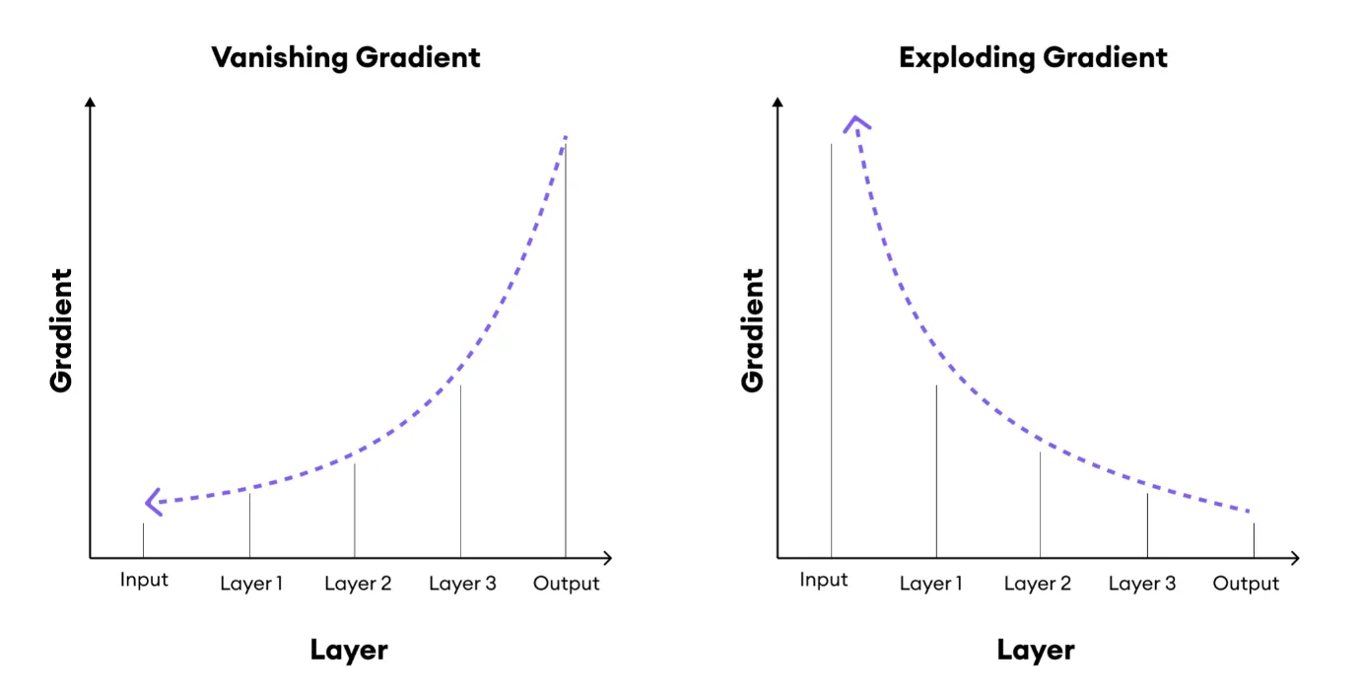
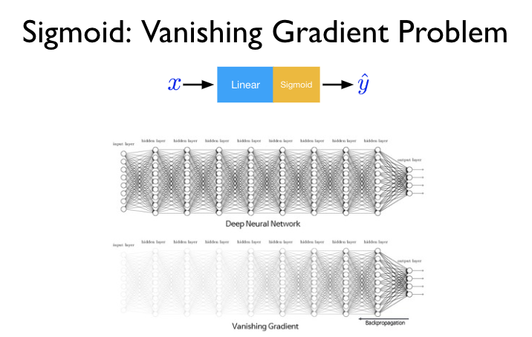
Vanish Gradient
Computer Vision - Prof. André Hochuli
Lecture 07
Notes:
Prof. André Hochuli

Slide 22
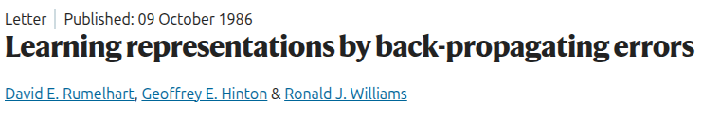
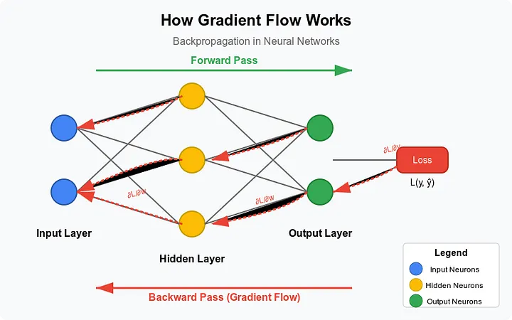
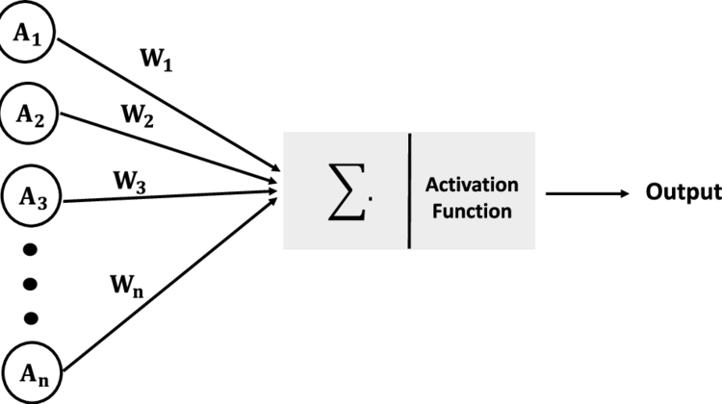
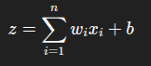
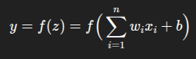
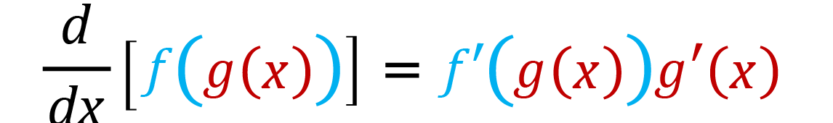
Vanish Gradient
Backpropagation multiplies gradients layer by layer using the chain rule.
Artificial Neuron
Activation
Computer Vision - Prof. André Hochuli
Lecture 07
Notes:
Prof. André Hochuli

Slide 23
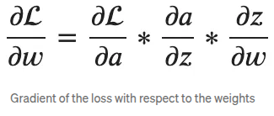
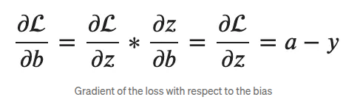
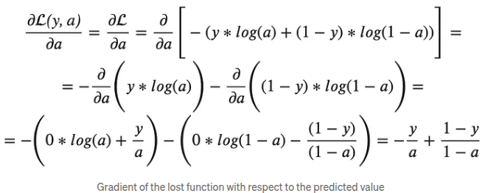
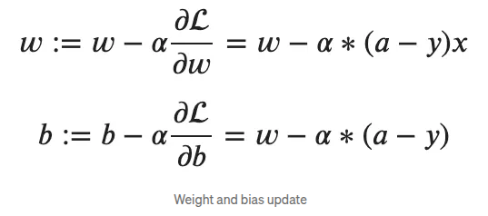
Vanish Gradient
Backpropagation multiplies gradients layer by layer using the chain rule.
Computer Vision - Prof. André Hochuli
Lecture 07
Notes:
Prof. André Hochuli

Slide 24
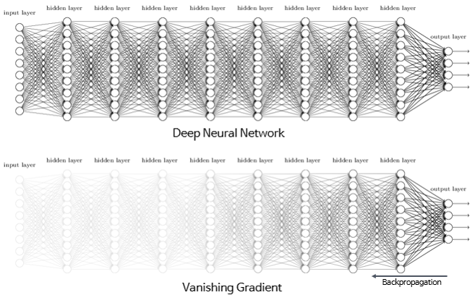
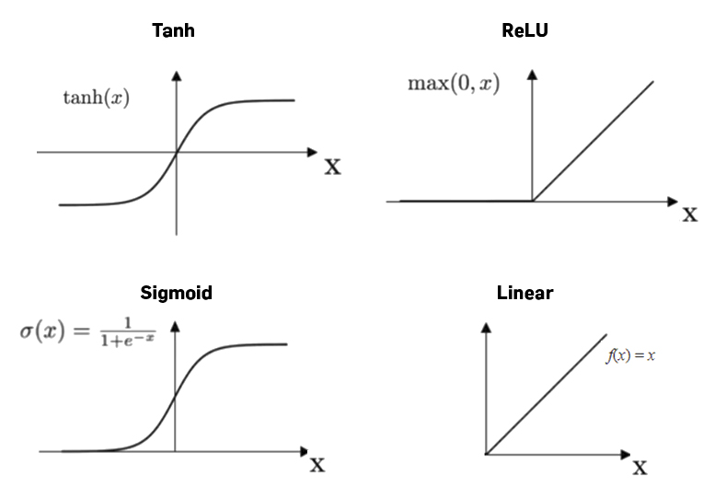
Vanish Gradient
Backpropagation multiplies gradients layer by layer using the chain rule.
If activation functions (like sigmoid or tanh) squash inputs into small ranges, their derivatives are less than 1.
Multiplying many numbers less than 1 across deep layers causes the gradient to shrink exponentially toward zero.
As a result, weight updates in early layers vanish, preventing effective training.
Computer Vision - Prof. André Hochuli
Lecture 07
Notes:
Prof. André Hochuli

Slide 25
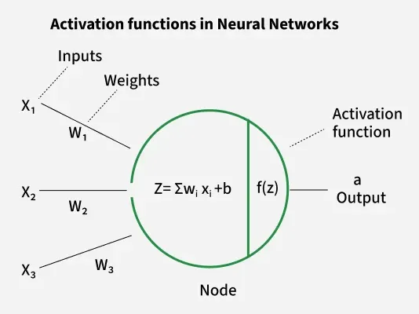
Mitigating The Vanish
ReLu Activation
Prevents saturation: Sigmoid/tanh saturate (gradient ≈ 0) for large or small values; ReLU does not.
Maintains gradient flow: Constant derivative (1) for x>0 preserves the backpropagation signal.
Computational simplicity: Direct calculation, no exponentials required.
Computer Vision - Prof. André Hochuli
Lecture 07
Notes:
Prof. André Hochuli

Slide 26
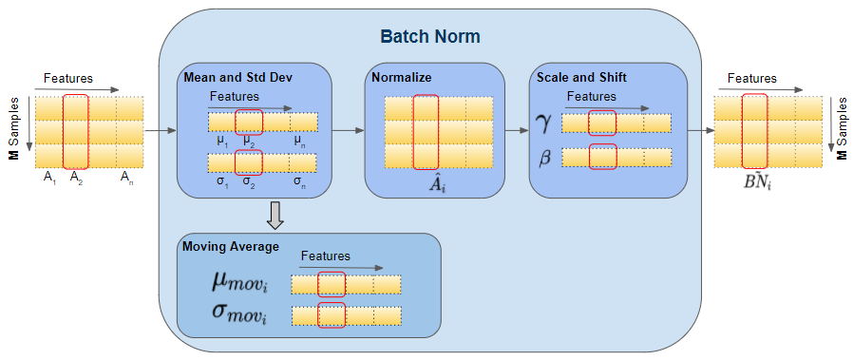
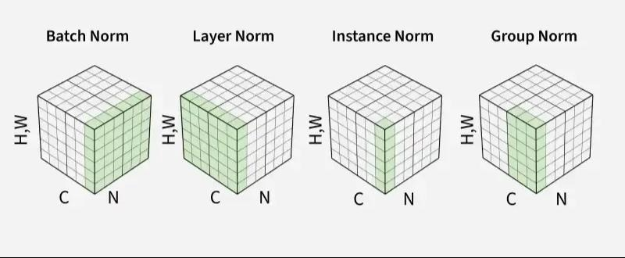
Mitigating The Vanish
Batch Normalization (BN)
BN normalizes the output of a layer before applying the activation function
For a given mini-batch, it computes the mean and variance of each feature/channel and scales the activations to have zero mean and unit variance.
BN keeps the distribution of activations stable, which prevents gradients from shrinking too much in deep networks.
It reduces the dependency of gradient magnitude on the scale of previous layers’ weights.
Helps gradients propagate more effectively.
Computer Vision - Prof. André Hochuli
Lecture 07
Notes:
Prof. André Hochuli

Slide 27
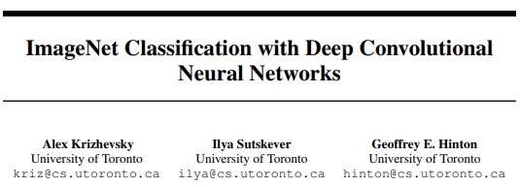
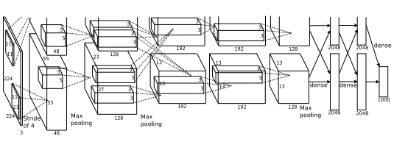
AlexNet
Architecture: 5 Conv layers + 3 Fully Connected layers, ReLU activations, Dropout.
IMAGENET Challenge 2012 – Error 16.4%
Introduced ReLU, GPU training, data augmentation, and dropout.
Parameters: ~61M.
Sparked modern deep learning revolution in computer vision.
Computer Vision - Prof. André Hochuli
Lecture 07
Notes:
Prof. André Hochuli

Slide 28
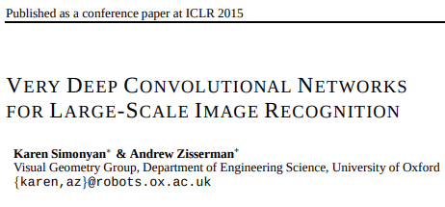
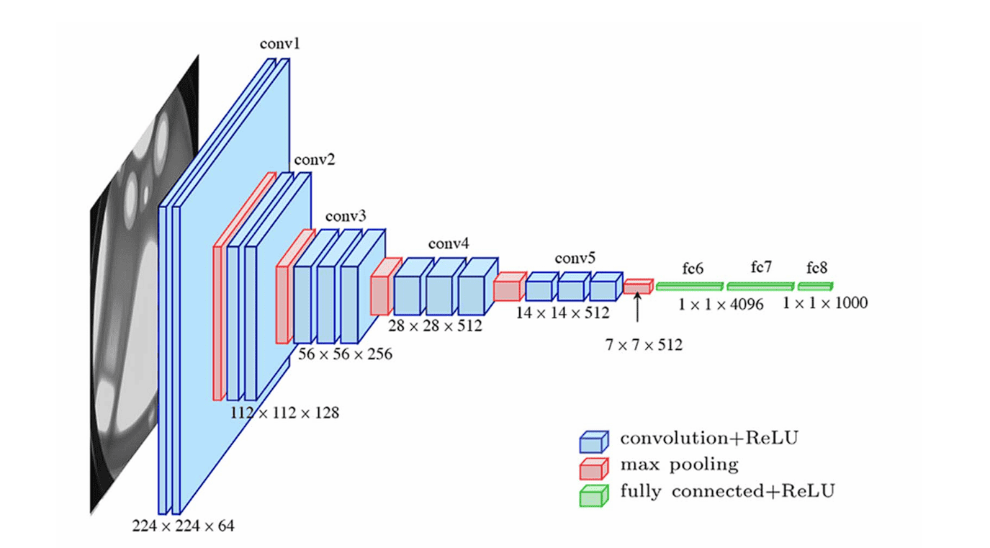
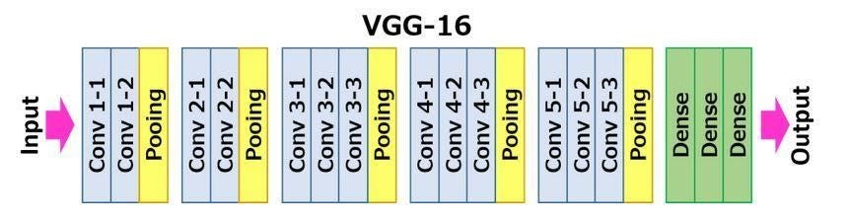
VGG16
Architecture: 13 Conv layers + 3 Fully Connected layers, small 3×3 filters.
IMAGENET Challenge 2012 – Error 6.7%
Key Features: Deep network using uniform architecture with small filters.
Parameters: ~138M.
Showed depth improves performance; standard baseline for many tasks.
Computer Vision - Prof. André Hochuli
Lecture 07
Notes:
Prof. André Hochuli

Slide 29
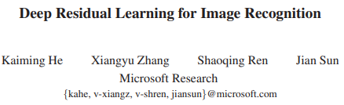
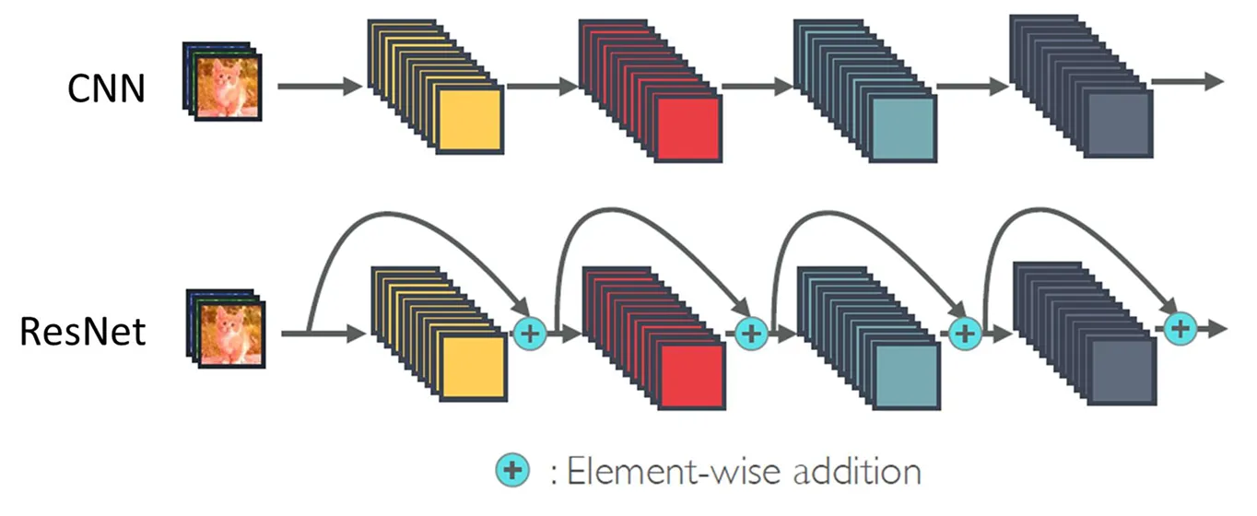
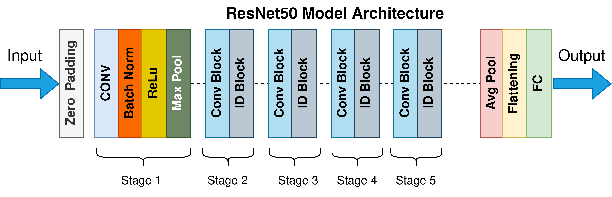
ResNet
Architecture: 50~152 layers with residual (skip) connections.
IMAGENET Challenge 2012 – Error 3.6%
Residual blocks enable training very deep networks (*).
Parameters: ~25M to ~60M.
Mitigates vanishing gradient problem; enabled ultra-deep networks.
(*) At this point the focus shifts from parameter-heavy networks to efficient architectures with better feature representation.
Computer Vision - Prof. André Hochuli
Lecture 07
Notes:
Prof. André Hochuli

Slide 30
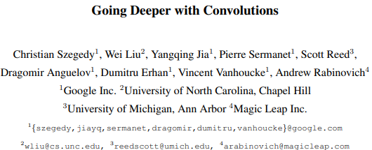
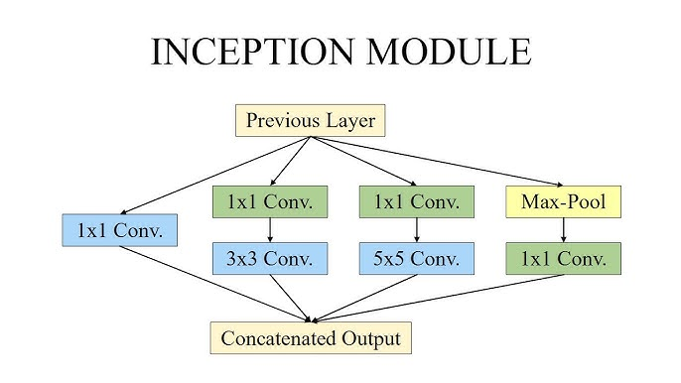
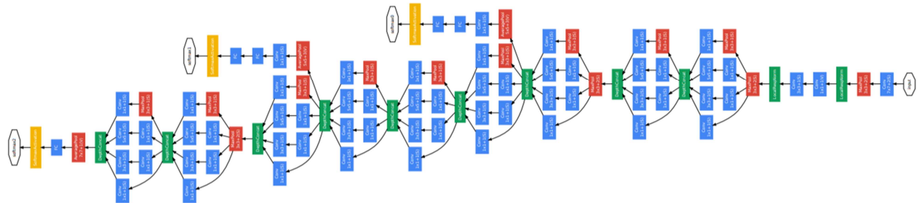
Inception
Architecture: Inception modules with multi-scale convolutions.
ImageNet classification
Efficient computation via factorized convolutions and dimension reduction.
Parameters: ~23.9M.
Combines depth and width efficiently; high accuracy with moderate compute
Computer Vision - Prof. André Hochuli
Lecture 07
Notes:
Prof. André Hochuli

Slide 31
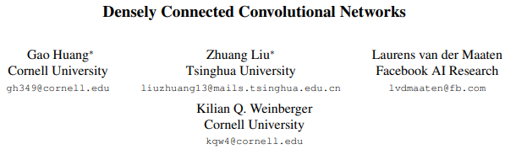
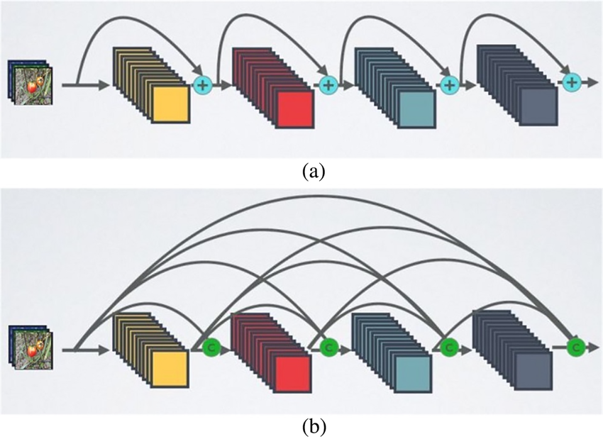
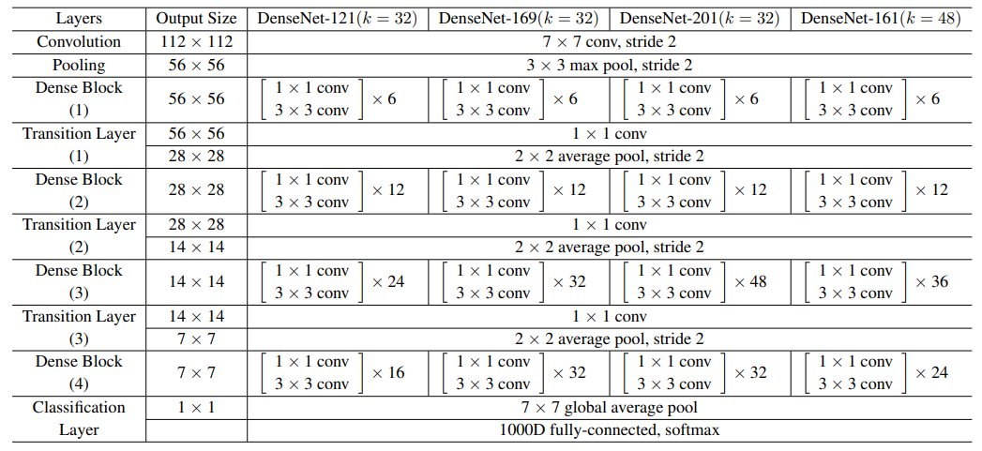
DenseNet
Architecture: 121 ~201 layers with dense connections (feature reuse). 1X1 Convs
ImageNet classification.
Each layer receives inputs from all previous layers.
Parameters: ~8M ~20M.
Significance: Reduces parameters while maintaining high performance; encourages feature reuse.
Computer Vision - Prof. André Hochuli
Lecture 07
Notes:
Prof. André Hochuli

Slide 32
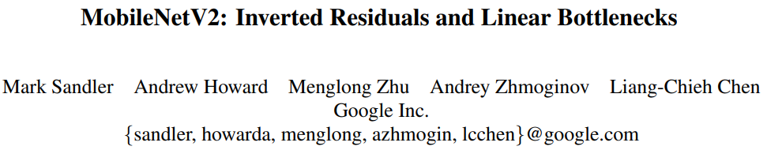
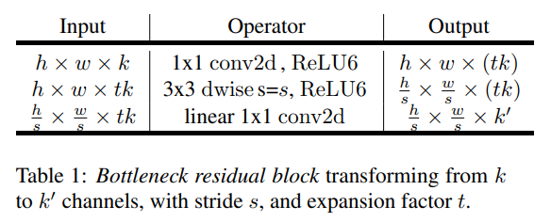


MobileNet
Architecture: 53 depthwise separable convolutions.
Mobile/embedded vision applications.
Inverted residual blocks, linear bottlenecks.
Parameters: ~3.4M.
Optimized for low-latency and low-memory devices.
Computer Vision - Prof. André Hochuli
Lecture 07
Notes:
Prof. André Hochuli

Slide 33




EfficientNet
Architecture: 16 ~81(*) MBConv blocks (depthwise + pointwise convs).
Dataset/Application: ImageNet classification.
Compound scaling of depth, width, and resolution.
Parameters: ~5.3M ~ 66M .
State-of-the-art efficiency; high accuracy with minimal compute.
Computer Vision - Prof. André Hochuli
Lecture 07
Notes:
Prof. André Hochuli

Slide 34
Let’s Code
Lecture 07 - CNN Architecture
Computer Vision - Prof. André Hochuli
Lecture 07
Notes:
Prof. André Hochuli

